Slide 1
Crop detection using AI and ML
Team members : Class – 5C
Sparsh dagar (2000290120163) Team guide – Dr harsh vardhan
Sumit agrawal (2000290120167)
Suryansh shuklaa (2000290120171)

Slide 2
Project Overview
In India, population is growing at a steady rate. Hence it is essential to increase the agricultural product through advanced technologies.
Crop detection/Leaf detection through AI and ML are needed. The production of crops gets affected by the presence of pests which results in large scale plant and crop disease.
Then there comes a new term “Agriculture intelligence”.
“Agriculture Intelligence is neither a product nor a system. It is an architecture, which is a collection of integrated operational as well as decision-support components, technologies and databases that provides the agriculture community easy access to agricultural knowledge.”
Plants are highly prone to diseases that affect the growth of the plant which in turn affects the ecology of the farmer. In order to detect a plant disease at very initial stage, use of automatic disease detection technique is advantageous.
So, For this we introduce some technique like ANN, RNN and smart sensors.

Slide 3
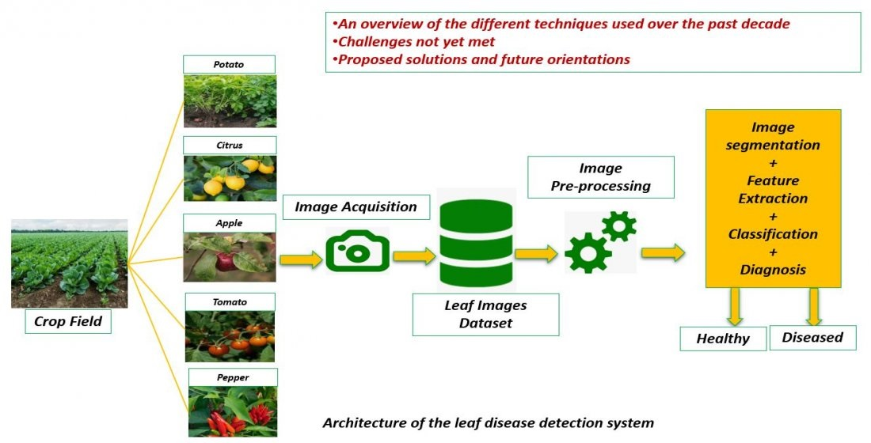
Proposed methodology
In the method by which we can detect the disease of a crop or the amount of pest and water needed by the crop we initially take high resolution photos of leaves by drones or cameras.
Then a dataset is maintained of the collected leaves. Since many images may be unsuitable for the application of technologies life ANN and RNN, therefore unclear images are filtered out.
The final set of collected images are used for further processing.
Technologies like Artificial neural network and Recurrent neural network are then used to study the segmented leaf images.
These technologies enable us to predict the results of the inputs that are supplied to the crops and help us to know more about the actual crop needs and demands in future.

Slide 4
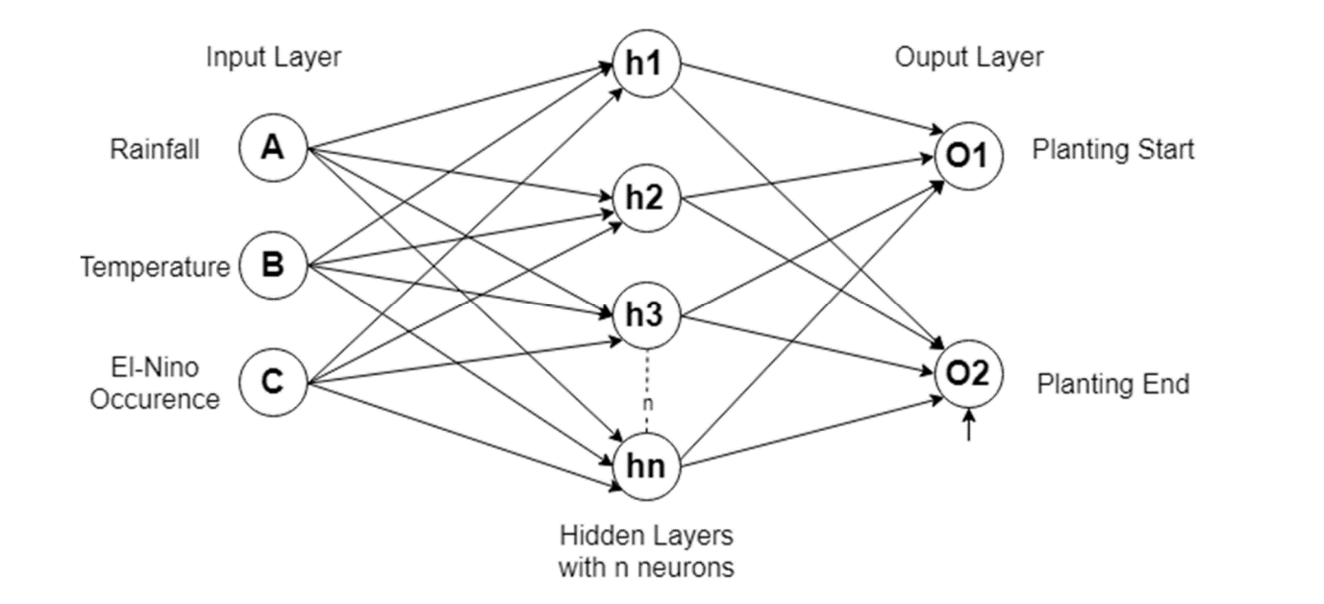
Artificial Neural Network (ANN)
Artificial Neural Network" is derived from Biological neural networks.
ANN develops the structure of a human brain. Similar to the human brain that has neurons interconnected to one another.
Artificial neural networks also have neurons that are interconnected to one another in various layers of the networks.
In leaf detection artificial neural network is used to predict the quantity of pests and water needed by the crop is per its previous requirements which are used as input in the ANN.

Slide 5
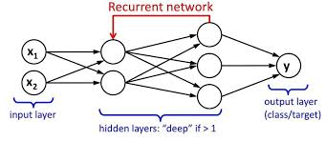
Recurrent Neural Network (RNN)
Recurrent Neural Network (RNN) are a type of Neural Network where the output from previous step is fed as input to the current step.
In traditional neural networks, all the inputs and outputs are independent of each other.
But in cases like when it is required to predict the next word of a sentence, the previous words are required and hence there is a need to remember the previous words.
Thus, RNN came into existence, which solved this issue with the help of a Hidden Layer.
The main and most important feature of RNN is Hidden state, which remembers some information about a sequence.

Slide 6
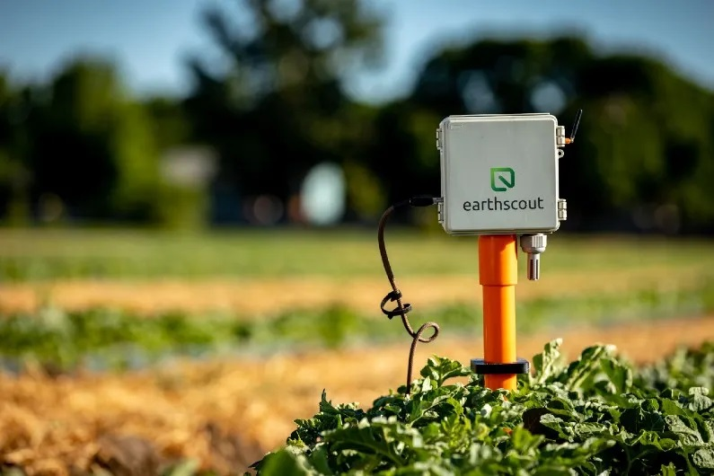
Smart Sensors
Smart sensors are used in the last second stage of the process to detect the at present composition of leaf.
The present composition of pests, water, and bacteria will be used to determine the in future requirements of the crop.
Hence making it possible to judge the required amount of pests and fertilizers required by the crops in particular season.
RNN will be using the data from smart sensors to supply the current state with the input.
The output of the current state will be used as an input for the next stage in RNN.

Slide 7
Conclusion
The proposed methodology in the following crop/leaf detection system focus on Generating an advance and efficient system which makes the process of creating high yield of crops much more easier for the farmers. The project aims to detect the pests, quality and most common diseases occurring on a crop, using image processing technique under Upbringing technology i.e., machine learning. In easier terms, the farmer will be able to accurately Detect the type of disease a particular plant is having using the image of the plant. The proposed System is based on three important modules namely:
ANN – Artificial Neural Network
RNN – Recurrent Neural Network
Smart sensors

